Slide 1




Bayesian Sparse Identification of Nonlinear Dynamics (Bayesian-SINDy)
NFFDy SP2
Leeds
arXiv preprint @
Lloyd Fung Research Fellow, Cambridge
Research Associate, Alan Turing Institute
L. Fung
Cambridge
U. Fasel
Imperial
M. Juniper
Cambridge
This work is supported by Peterhouse Research Fellowship.

Slide 2


B-SINDy
Turing.jl

Slide 3
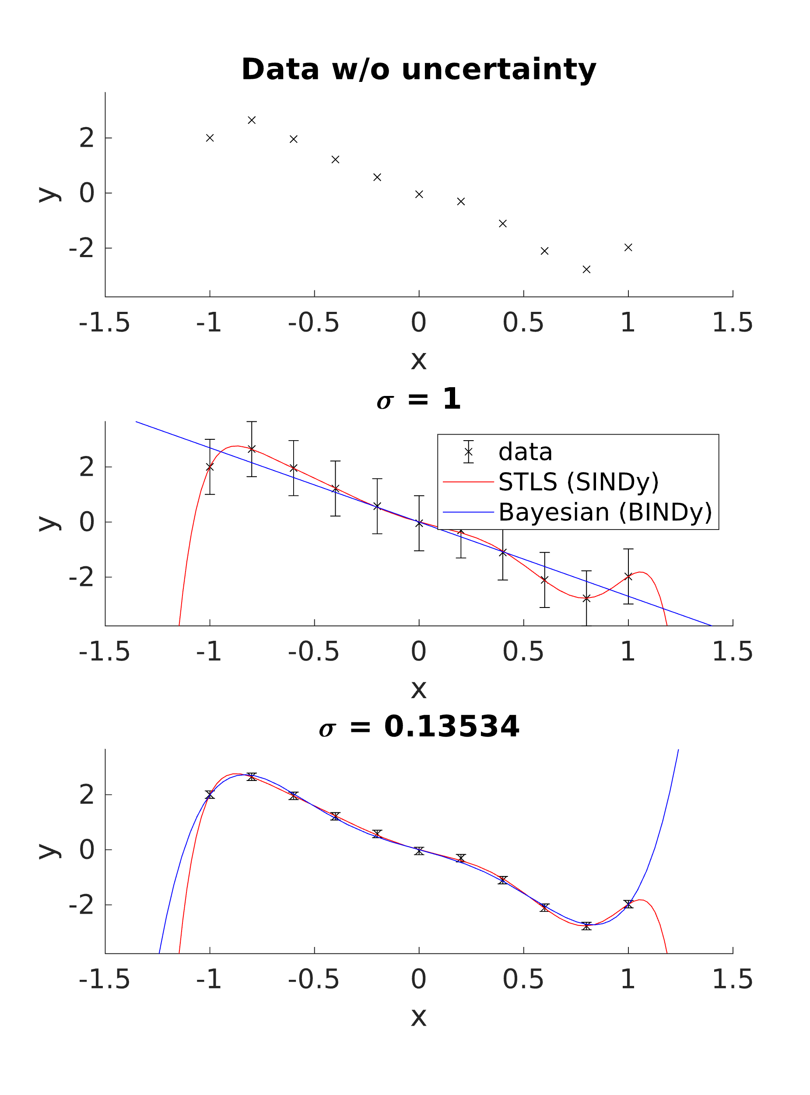
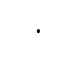
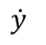
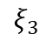
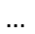

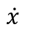
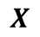
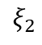
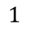
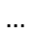
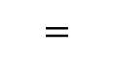
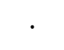
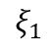
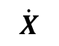
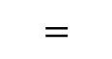
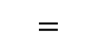
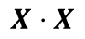
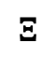
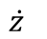
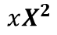
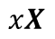
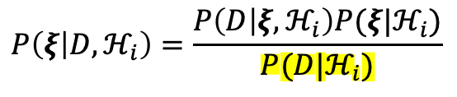
B-SINDy = Bayesian Sparse Regression
Candidate Functions
Learnt Coefficients
Dynamics
$$=$$
$$⋅$$
$$\dot{X}$$
$$=$$
$$Θ\left(X\right)$$
$$⋅$$
$$Ξ$$
$$=$$
$$…$$
$$…$$
$$…$$
$$ξ_{1}$$
$$ξ_{2}$$
$$ξ_{3}$$
$$\dot{x}$$
$$\dot{y}$$
$$\dot{z}$$
$$1$$
$$X$$
$$xX$$
$$X⋅X$$
$$xX^{2}$$
SINDy-typed regression = Sparse Regression
+
Bayesian model selection by Evidence
likelihood
prior
posterior
$$P\left(ξ | D,ℋ_{i}\right)=\frac{P\left(D | ξ,ℋ_{i}\right)P(ξ|ℋ_{i})}{P(D|ℋ_{i})}$$
evidence

Slide 4
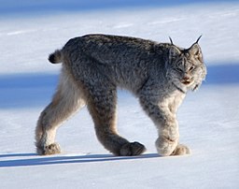
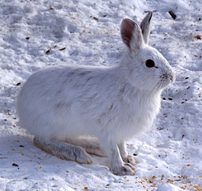
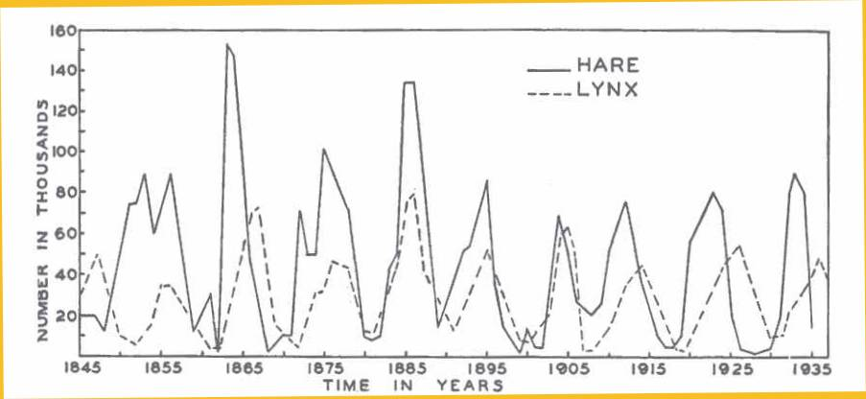
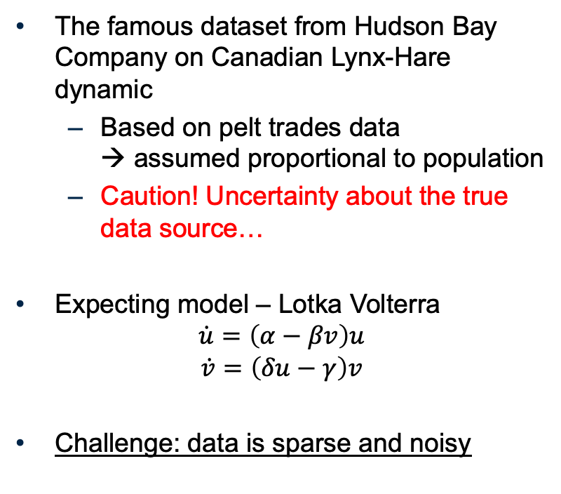
Model selection for Predator-Prey dynamics
The famous dataset from Hudson Bay Company on Canadian Lynx-Hare dynamic
Based on pelt trades data → assumed proportional to population
Caution! Uncertainty about the true data source…
Expecting model – Lotka Volterra
$$\dot{u}=\left(α−βv\right)u$$
$$\dot{v}=\left(δu−γ\right)v$$
Challenge: data is sparse and noisy

Slide 5
Let’s try to learn the Lotka-Volterra model!
(To tutorial LotkaVolterra.mlx)

Slide 6
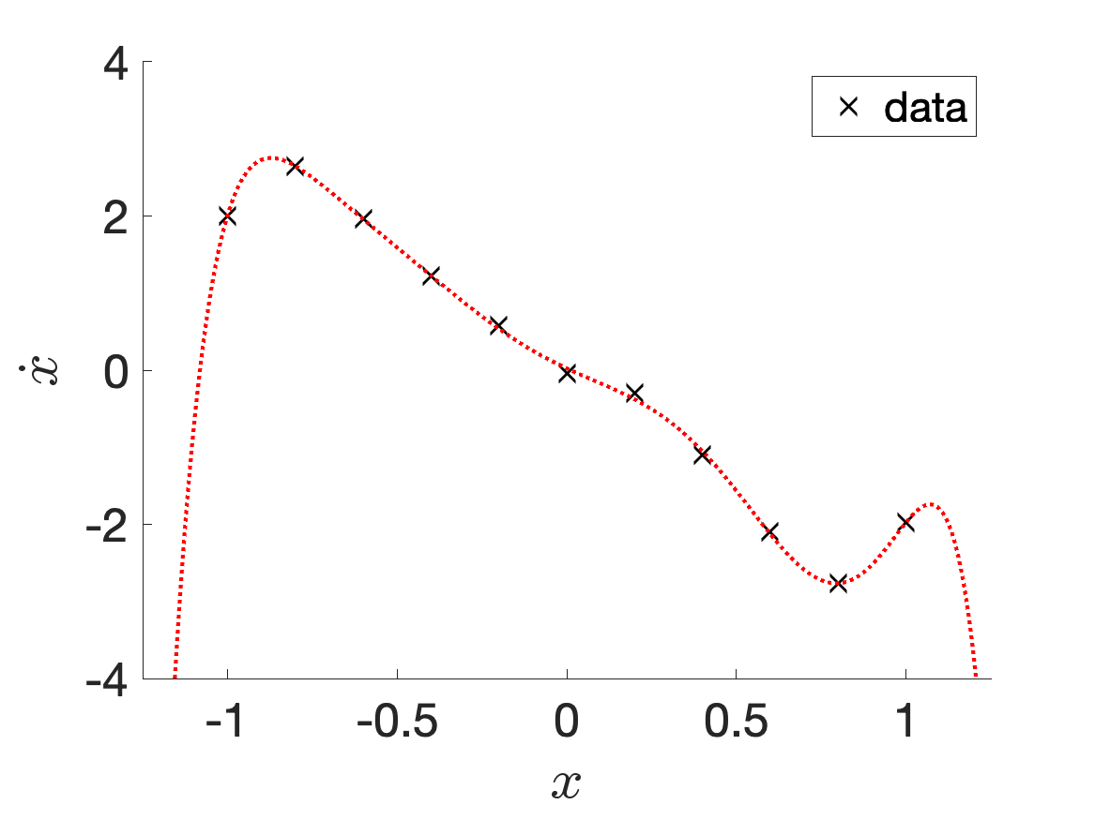
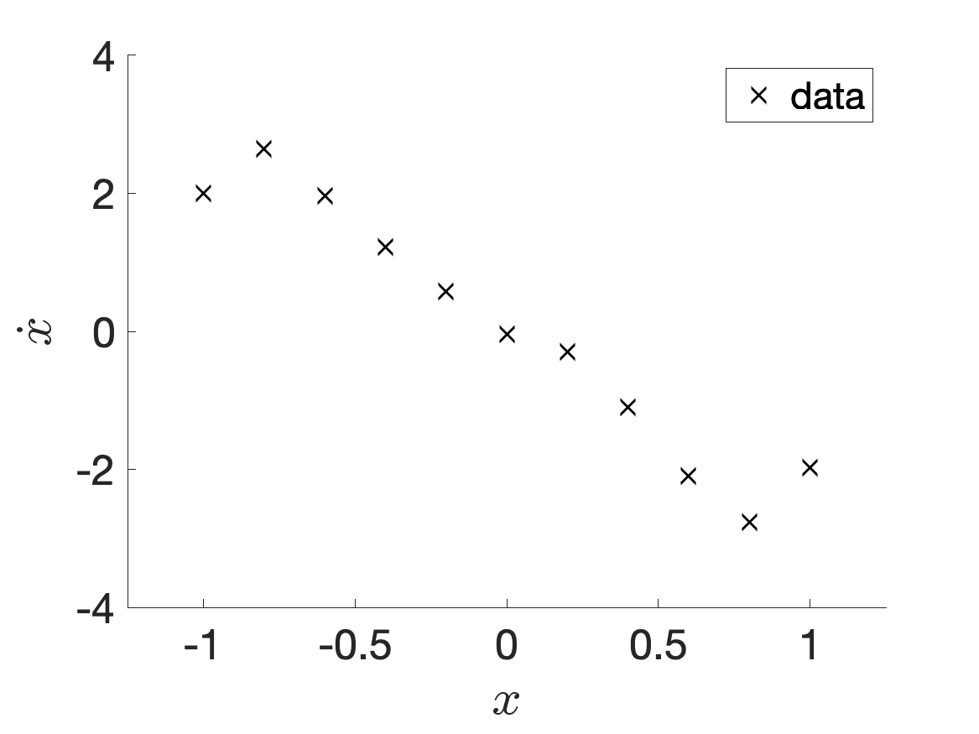
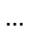
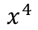
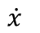
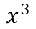
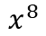
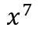
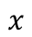
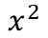
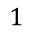
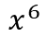
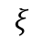
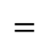
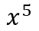
SINDy = Sparse Regression
$$=$$
$$…$$
$$ξ$$
$$\dot{x}$$
$$1$$
$$x$$
$$x^{2}$$
$$x^{3}$$
$$x^{4}$$
$$x^{5}$$
$$x^{6}$$
$$x^{7}$$
$$x^{8}$$

Slide 7

SINDy = Sparse Regression
$$=$$
$$…$$
$$ξ$$
$$\dot{x}$$
$$1$$
$$x$$
$$x^{2}$$
$$x^{3}$$
$$x^{4}$$
$$x^{5}$$
$$x^{6}$$
$$x^{7}$$
$$x^{8}$$

Slide 8
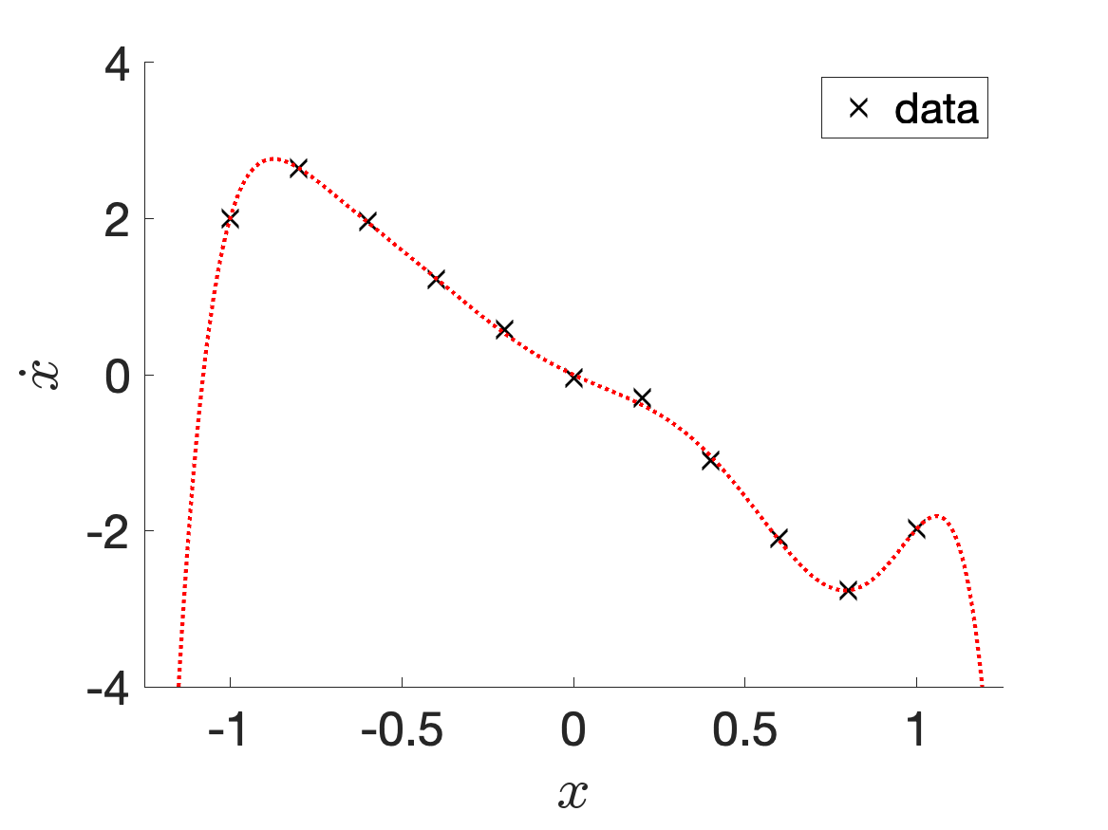
SINDy = Sparse Regression
$$=$$
$$…$$
$$ξ$$
$$\dot{x}$$
$$1$$
$$x$$
$$x^{2}$$
$$x^{3}$$
$$x^{4}$$
$$x^{5}$$
$$x^{6}$$
$$x^{7}$$
$$x^{8}$$

Slide 9
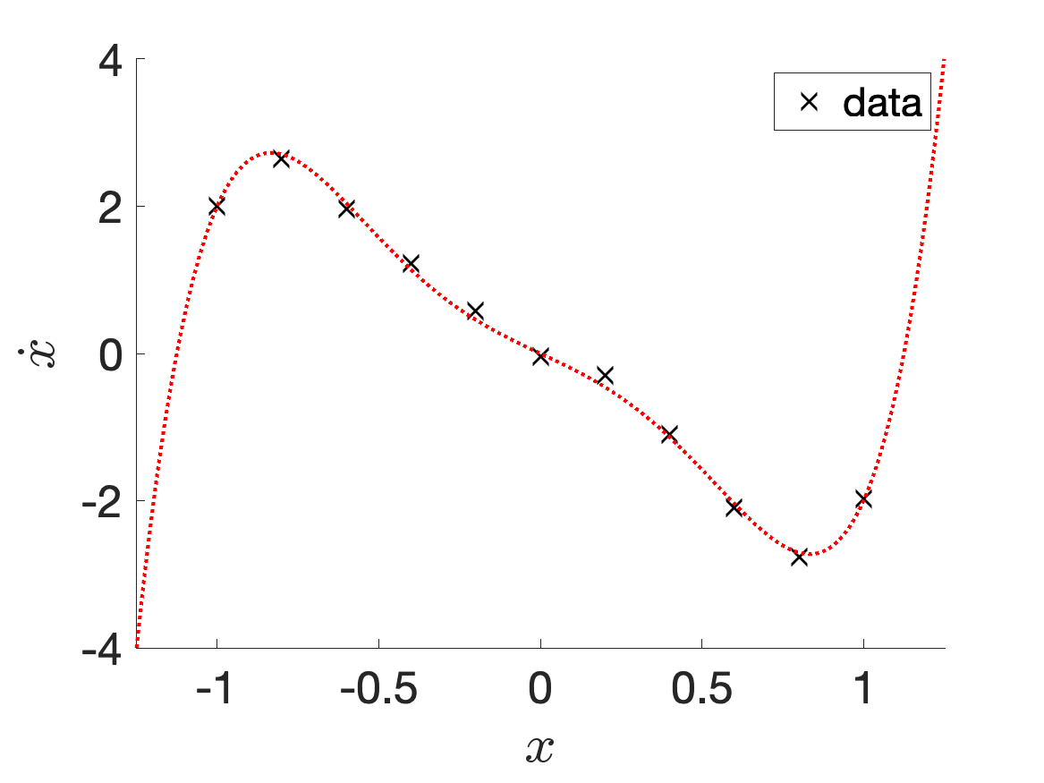
SINDy = Sparse Regression
$$=$$
$$…$$
$$ξ$$
$$\dot{x}$$
$$1$$
$$x$$
$$x^{2}$$
$$x^{3}$$
$$x^{4}$$
$$x^{5}$$
$$x^{6}$$
$$x^{7}$$
$$x^{8}$$

Slide 10
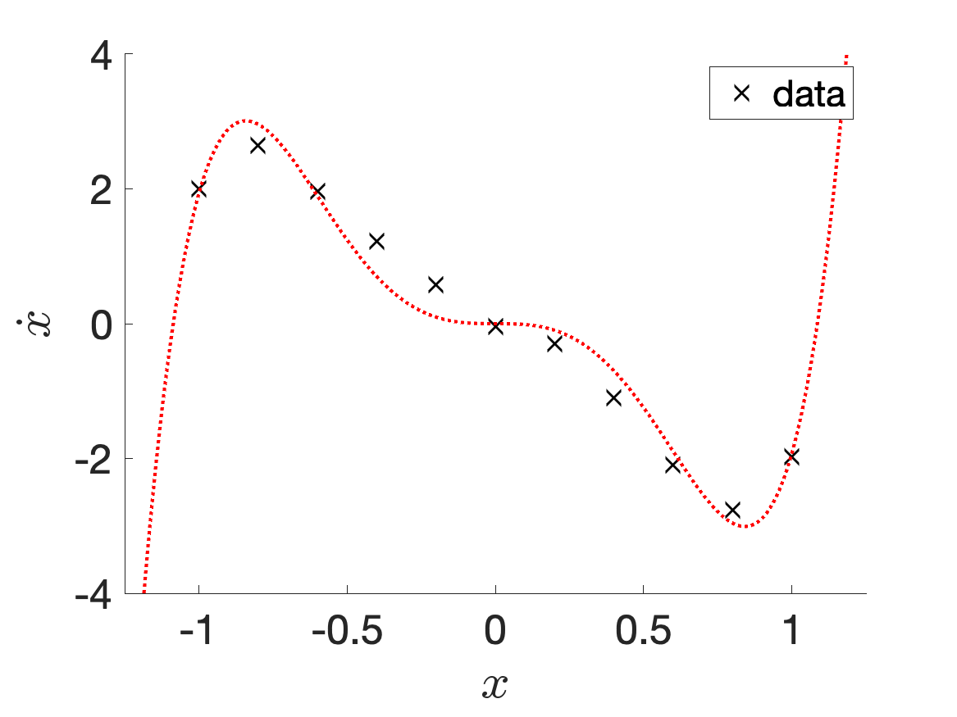
SINDy = Sparse Regression
$$=$$
$$…$$
$$ξ$$
$$\dot{x}$$
$$1$$
$$x$$
$$x^{2}$$
$$x^{3}$$
$$x^{4}$$
$$x^{5}$$
$$x^{6}$$
$$x^{7}$$
$$x^{8}$$

Slide 11
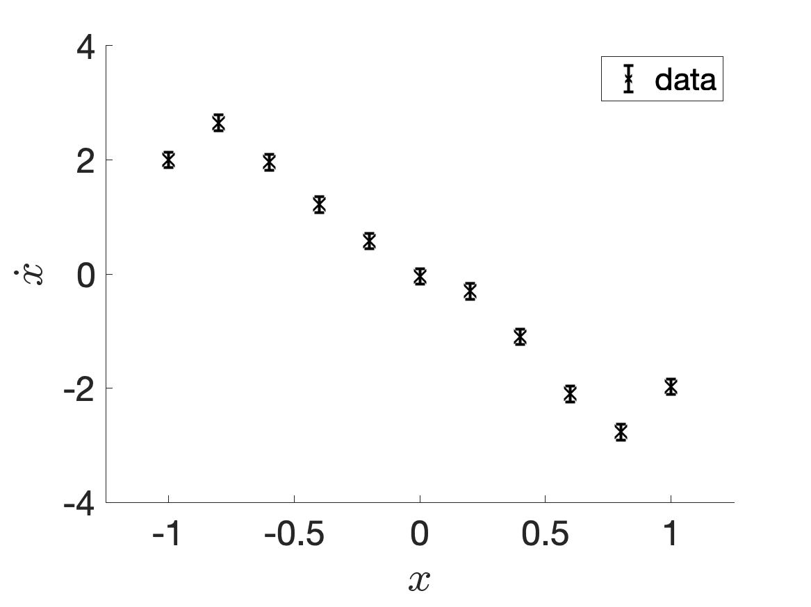
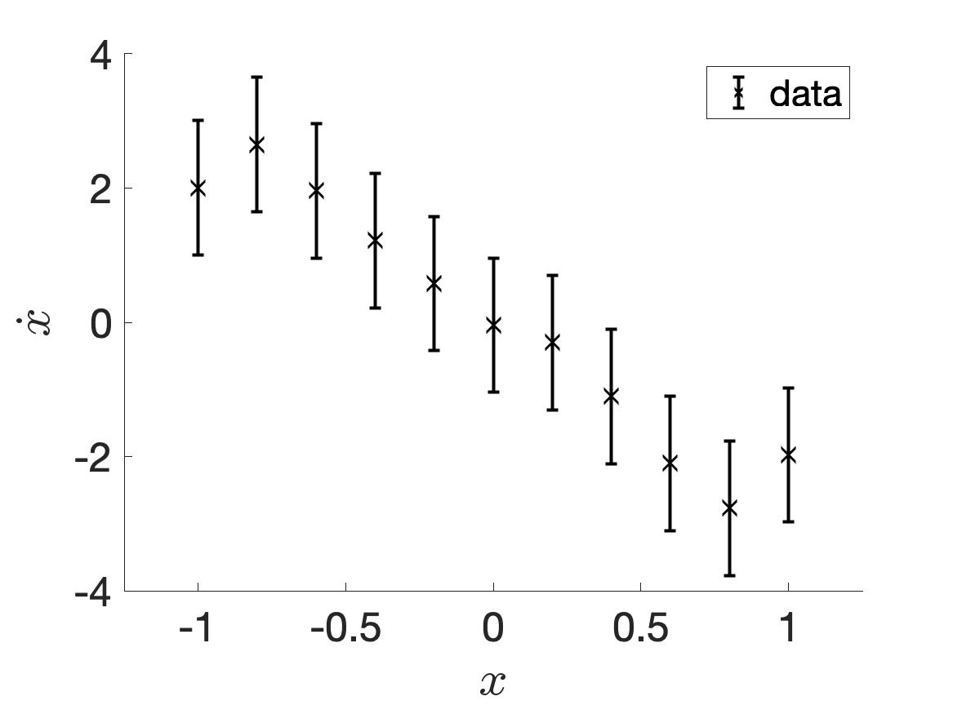
Uncertainty in the data?

Slide 12
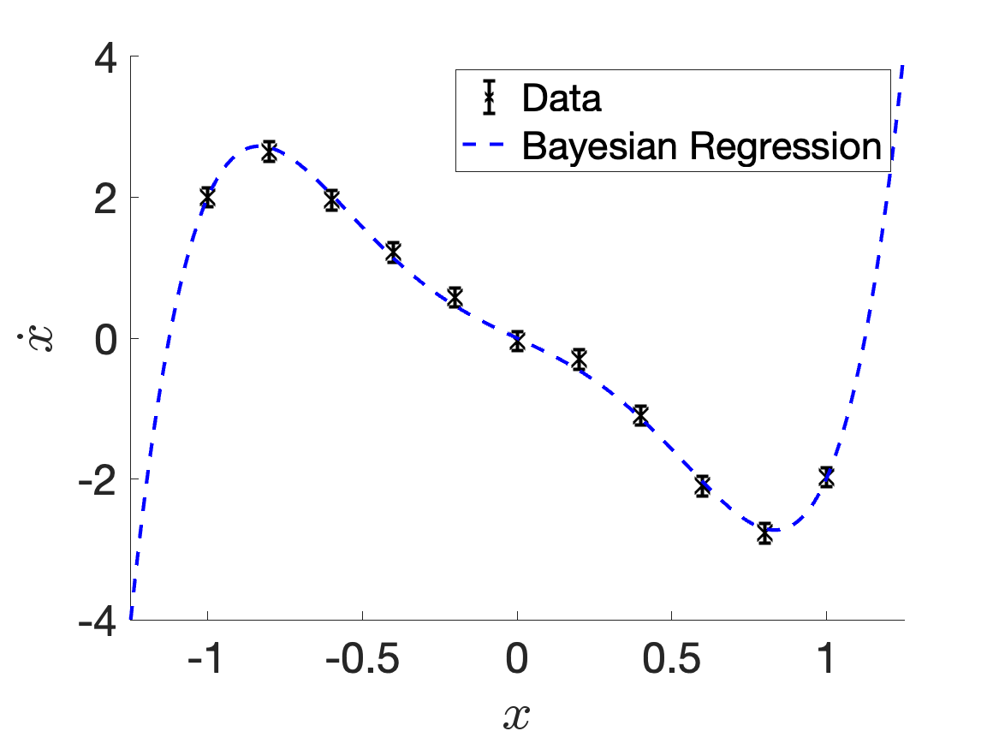
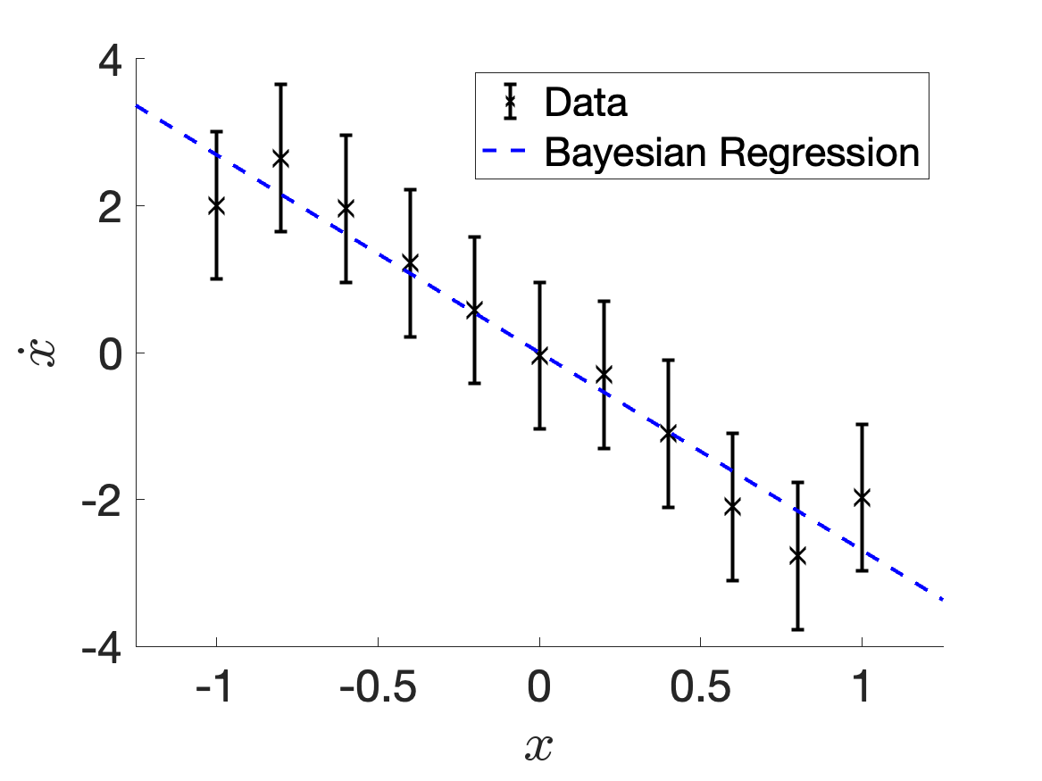
Uncertainty in the data?

Slide 13
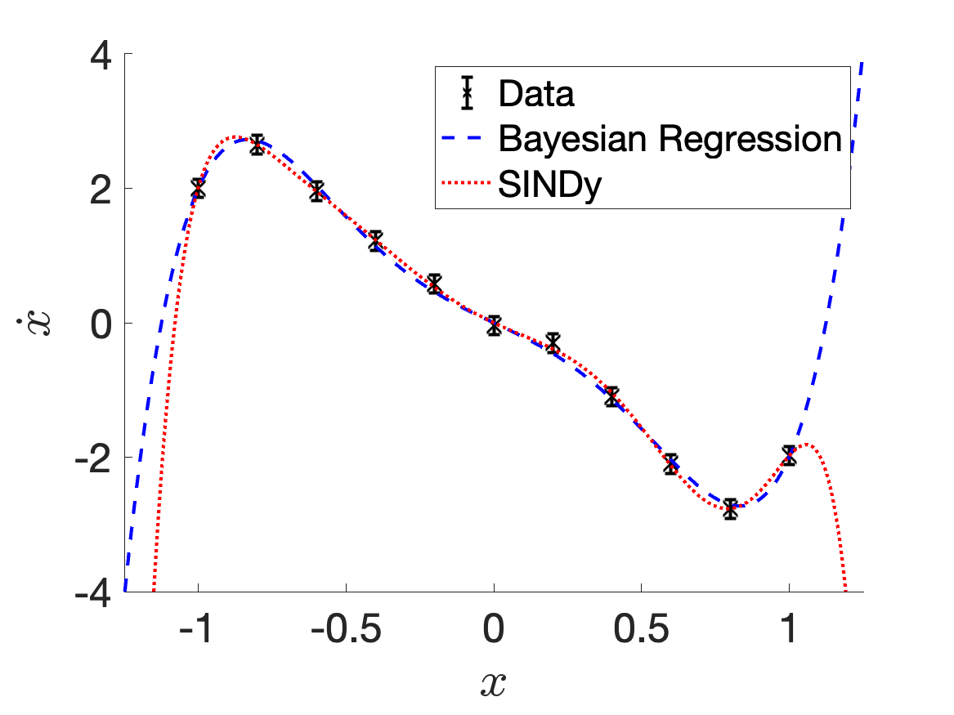
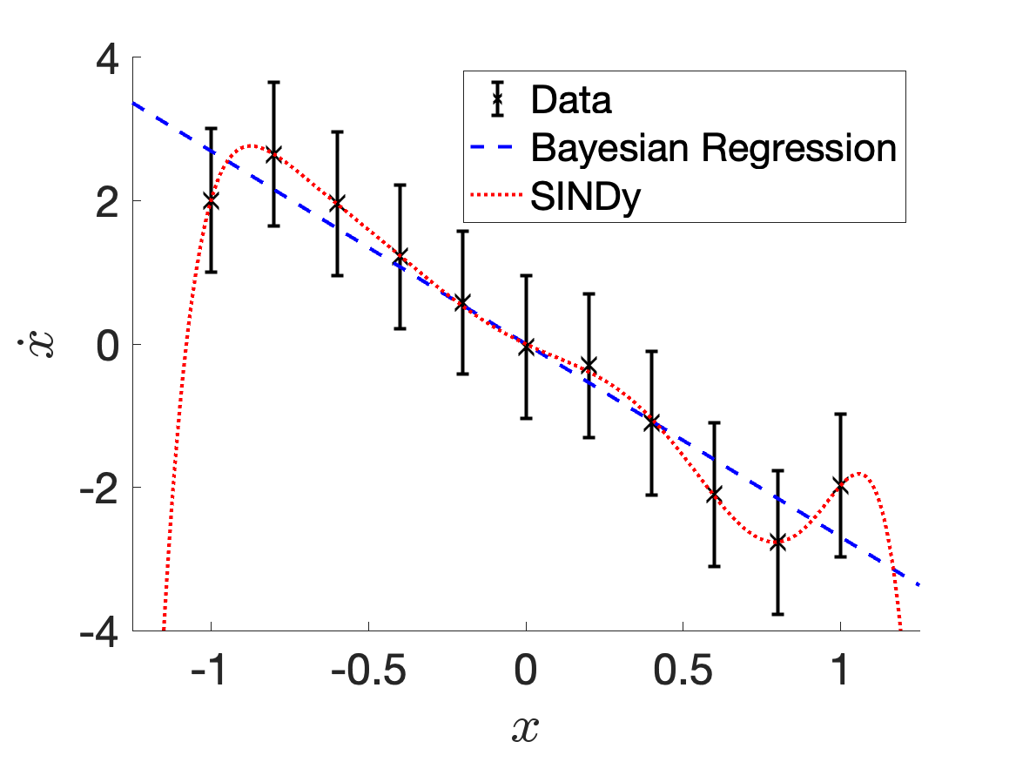
Uncertainty in the data?

Slide 14






Bayes’ Theorem
likelihood
prior
$$P\left(ξ | D,ℋ_{i}\right)=\frac{P\left(D | ξ,ℋ_{i}\right)P(ξ|ℋ_{i})}{P(D|ℋ_{i})}$$
posterior
evidence
Model selection under Bayes
$$D=\{x_{i},y_{i}\}$$
Data
$$\underset{ℋ_{i}}{argmax}{P(ℋ_{i}|D)}$$
$$ℋ_{i}$$
Hypothesis (model basis)
where
$$ξ$$
Fitting parameters
$$P(ℋ_{i}|D)∝P\left(D | ℋ_{i}\right)P(ℋ_{i})$$

Slide 15








Bayes’ Theorem & Regression
$D=\{x,\dot{x}\}$
Data
$ℳ_{i}$
Model
Bayes’ rule
likelihood
prior
$Θ_{ℳ}\left(x\right)$
Model Basis
$$P\left(ξ | D,ℳ_{i}\right)=\frac{P\left(D | ξ,ℳ_{i}\right)P(ξ|ℳ_{i})}{P(D|ℳ_{i})}$$
$ξ$
Fitting parameters
posterior
evidence
$$−\ln{P}$$
Assume$\dot{x}\sim 𝒩\left(Θ_{ℳ}\left(x\right)⋅ξ,σ^{2}\right):$
error
$$−\ln{P\left(ξ | D,ℳ_{i}\right)}=\frac{1}{2σ^{2}}{\left\|\dot{x}−Θ_{ℳ}\left(x\right)⋅ξ\right\|}_{2}^{2}+Ω({\left\|ξ\right\|}_{n}^{})+normalise$$
posterior
likelihood
Prior (L_{n} regularisation)
Maximum a posteriori (MAP):
$$ξ_{MAP}=\underset{ξ}{argmax}{P\left(ξ | D,ℳ_{i}\right)}$$
Regularised Regression (Regularisation ↔ prior)

Slide 16

















Model selection by Evidence
$$\underset{ℳ_{i}}{argmax}{P(ℳ_{i}|D)}$$
Aim:
Assuming the prior to all models ${P(ℳ}_{i})$ is uniform:
$$=\int_{ξ}{P\left(D | ξ,ℳ_{i}\right)P\left(ξ | ℳ_{i}\right)dξ}$$
$$A=σ_{prior}^{−2}I+σ_{}^{−2}{Θ_{ℳ}}^{T}Θ_{ℳ}$$
$$P\left(ℳ_{i} | D\right)∝P\left(D | ℳ_{i}\right)$$
(approximating by Laplace method)
Prior: $ξ$ magnitude
Uncertainty in $ξ$
$$≈P\left(D | ξ_{MAP},ℳ_{i}\right)P\left(ξ_{MAP} | ℳ_{i}\right){\left[\det\left(\frac{A}{2π}\right)\right]}^{−1/2}$$
Penalizes models with too many param.
Obtained from linear regression
Likelihood @ MAP
Occam Factor
$\sim O(\#Data)$ $O(σ^{−2})$
$$\sim O(\#Basis)$$
When $\#Data≫\#Basis$,
$$D=\{x,\dot{x}\}$$
$$P\left(D | ξ_{MAP},ℳ_{i}\right)≈P\left(D | ℳ_{i}\right)$$
SINDy works
Data
$$ℳ_{i}$$
Model
When $\#Data \sim \#Basis$,
$$ξ$$
Fitting parameters
$$P\left(D | ξ_{MAP},ℳ_{i}\right)\sim P\left(ξ_{MAP} | ℳ_{i}\right){\left[\det\left(\frac{A}{2π}\right)\right]}^{−1/2}$$
B-SINDy works better
$$A$$
Parameter Covariance

Slide 17


Composition of Evidence during Bayesian Model Selection
$$\#Data=200, σ=0.2$$

Slide 18

Composition of Evidence during Bayesian Model Selection
$$\#Data=50, σ=2$$

Slide 19


Successful Applications of Bayesian-SINDy to Real-life Data
Lynx and Hare population in Canada
Projection based on pelts trades by the Hudson Bay Company
Annual data collected between 1900-1920
Only consists of 21 data points
Classical dataset to demonstrate the Lotka-Volterra equation governing population dynamics
SINDy:
$$\dot{u}=11.3+0.091u−0.74v \\ \dot{v}=−18.4+0.57u−0.074v$$
B-SINDy:
$$\dot{u}= 0.45u−0.022uv \\ \dot{v}=−1.05v+0.029uv$$
Lotka-Volterra eqn.!

Slide 20


Conclusion
B-SINDy is a more robust framework to learn and select models than SINDy
It is just as fast as SINDy
Takes into account the uncertainty in the data
Works better than SINDy in the small and noisy datasets
B-SINDy also gives uncertainties in the parameters (i.e. Uncertainty Quantification)
Future work
Extending B-SINDy with information theory
Active Learning
Learning a common model from several datasets
arXiv preprint @
Collaborators:
U. Fasel
Imperial
M. Juniper
Cambridge
This work is supported by Peterhouse Research Fellowship.

